Slide 1
Solution to manufacturing production optimization
A deep learning approach

Slide 2
IDEA
In this project I am considering the use of Deep Learning to solve optimization problem specifically Reinforcement Learning which I will present the strategy to use it in this kind of case
As a fundamental part of analyzing the historical data I can work on the use of Recurrent Neural Networks explaining how they can be implemented and efficiently used in this problem
This is a work justifying the use of RL and RNN in solving Optimization for Manufacturing suggesting a model that can tackle this problem and that can show the importance of AI in Industries right now

Slide 3
Reinforcement Learning
Classical optimization methods, such as dynamic programming cannot, be applied here because they require transition model to predict the next state distribution, given the current state and action.
Reinforcement learning is an ideal approach for optimization models, since these generate sample trajectories through the state space as the agent experiments with its current policy.

Slide 4
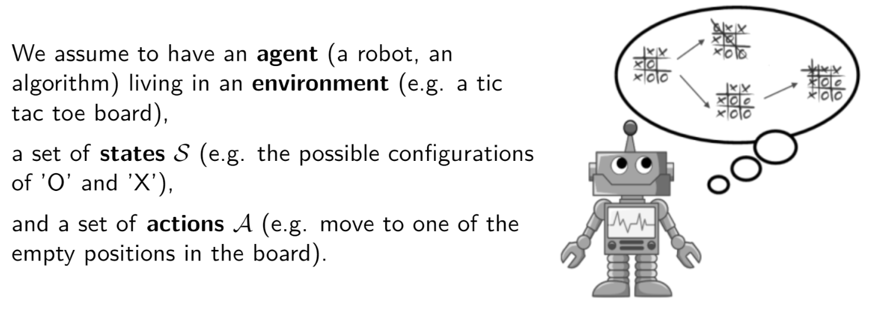
Mechanism

Slide 5
MDP
RL models the sequential decision making problem faced by an agent as a Markov Decision Process (MDP) .
The aim of the agent is to learn a policy of mapping states to actions that maximizes its performance on the task.
A MDP is a tuple (S, A, T, R) in which S is a finite set of states, A a finite set of actions, T a transaction probability function T: S x A x S -> [0,1] and R a reward function, R : S x A x S -> |R
T and R define the model of the MDP

Slide 6
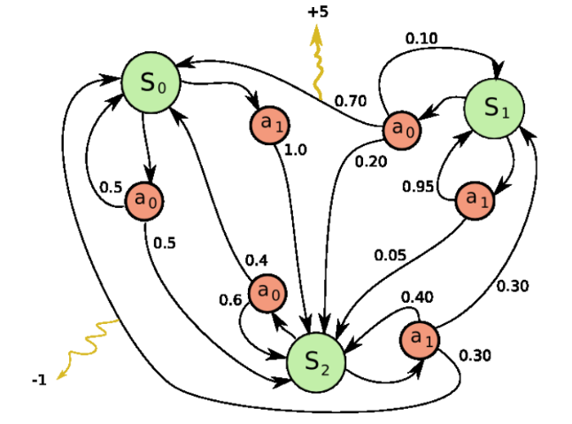
MDP

Slide 7
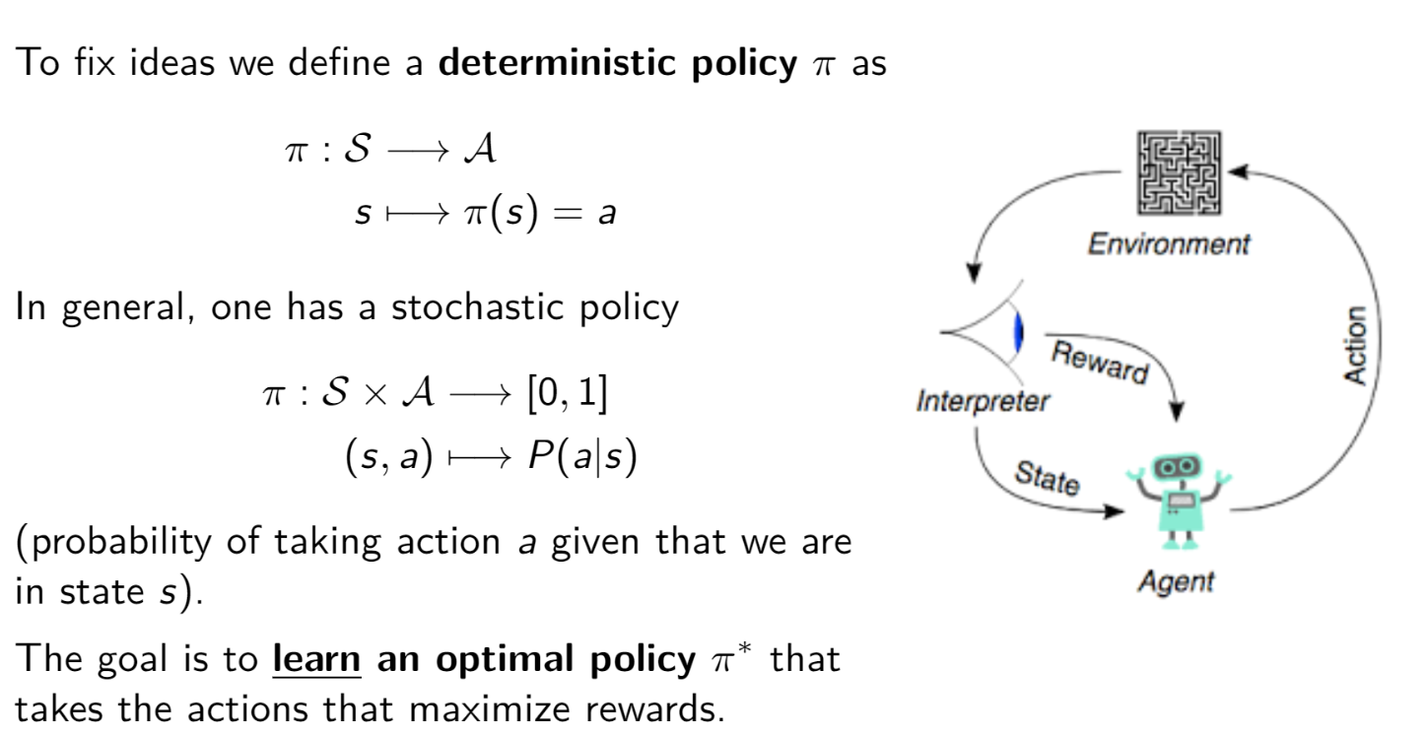
Agent’s policy to control MDP

Slide 8
Agent’s policy to control MDP
To find a good policy we could use valued-based methods to measure how good an action is in a particular state or policy-based methods to directly find out what actions to take under different states without knowing how good the actions are.
In order to be used in Reinforcement Learning , states and actions need to fulfill the criteria of a Markov Decision Process (MDP)

Slide 9
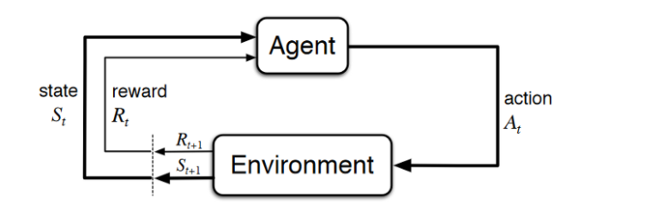
Agent’s policy
The agent-environment interaction in a Markov decision process

Slide 10
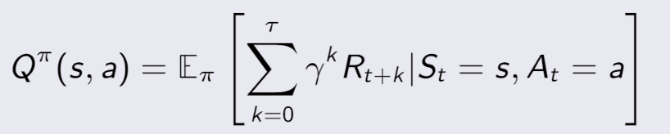
Q-learning
Value-based method as a way to quantify goodness of action-state pairs
The state-action value of s,a under policy π is the expected return when starting in state s, taking action a and thereafter following π:

Slide 11

Optimal Q-values and policy
A policy π* is said to be optimal if it such that
Greedily select an optimal action using the greedy Q-policy πQ defined as πQ(s) = arg max a∈A(s) Q ∗ (s, a), ∀s ∈ S, and πQ is an optimal policy according to the definition above.

Slide 12
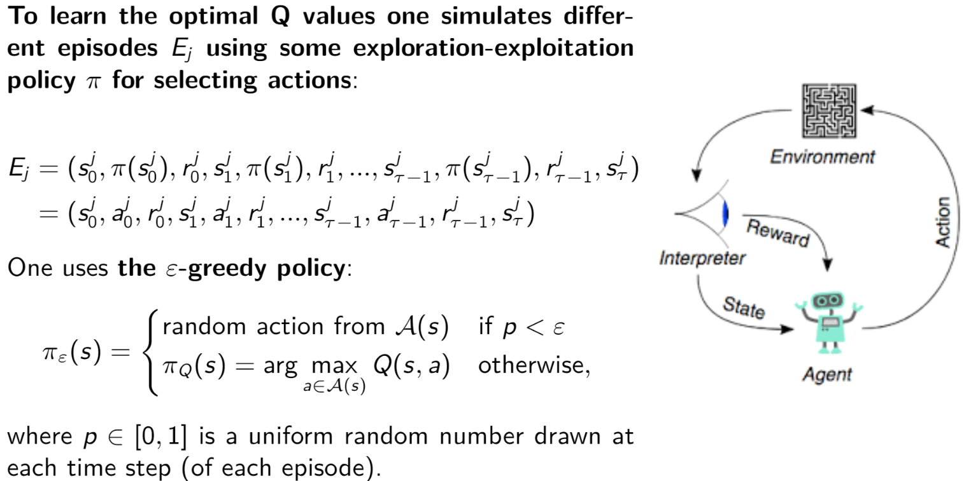
Greedy Q Policy

Slide 13
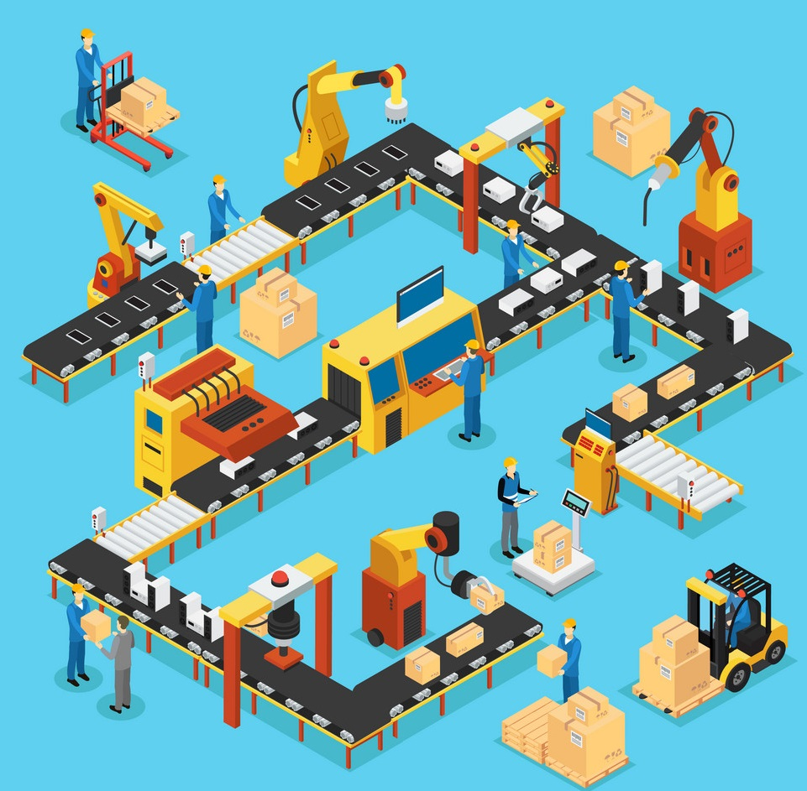
Q-learning environment for Production line
States: Current inventory, Total orders
Agent: Warehouse
Action: Current order
Reward: Total Supply Cost
Total Cost: max(capacity, holding_cost*current_inventory)
+ totalOrders_cost*totalOrders
Algorithm: n step Q-Learning

Slide 14
Q-learning environment for Production line
In this section I would design a Q-learning environment for production line problem
I will investigate the performance of reinforcement learning (RL) agents within it
Model the environment as a Markov decision process (MDP) where during each step it needs to be decided how many orders should be taken to minimize the cost

Slide 15
Q-learning environment for Production line
State: inventory level - Total orders level
Incoming orders can follow a normal (gaussian) distribution for test
I will set the work with a sample dataset and test the performance along the way
This sets the coding background and will be tested on RL library

Slide 16
[Theory]Production Optimization Problem
Inspiration to this idea comes from the beer game where you need to manage orders from
The challenge is to ensure an optimistic delivery system where we try to have the lowest total cost in the end
The Q learning algorithm is used to make the agent which is a warehouse responsible for the production to follow the policy that optimizes through minimizing the cost as a reward system
The idea is to create an automatic simulation of the process where we have an initial inventory, client orders, a backlog to follow, outgoing orders , the upstream of deliveries the minimum cost to respect

Slide 17
[Code]Production Optimization Problem
Some constraints must be considered in this equation :
Delays: demands may not be fulfilled immediately and supplier may also be out of stock and will then have to pass is own order.
Inventory Costs: If too many orders, inventory costs will rise, because more resources will be needed to handle the inventory and more storage space.
Backorder Costs: If order it too low, inventory will bot be sufficient to supply client.
The code is divided into two scripts , main.py is where a class is defined to objectify our system which makes it easy to hold all the components (variables and functions) and the can be called in the notebook where the training of the q learning algorithm will happen

Slide 18
[Code]Production Optimization Problem
The algorithm will be trained over episodes of weeks for a simulation over one year and will be minimizing the total cost all along the time
The reward system will be updated through the random deliveries form the pending upstream optimizing the cost
A training dataset is generated with the mentioned variables of the system created into features

Slide 19
[Code]Production Optimization Problem
The greedy Q policy was used to generate the optimistic action values which are the number outgoing orders and
Rewards try to keep the most minimum cost throughout the exploration exploit concept of greedy system all along the number of episodes
After the training historical data is generated we can visualize the optimization of total cost by rolling over several weeks

Slide 20
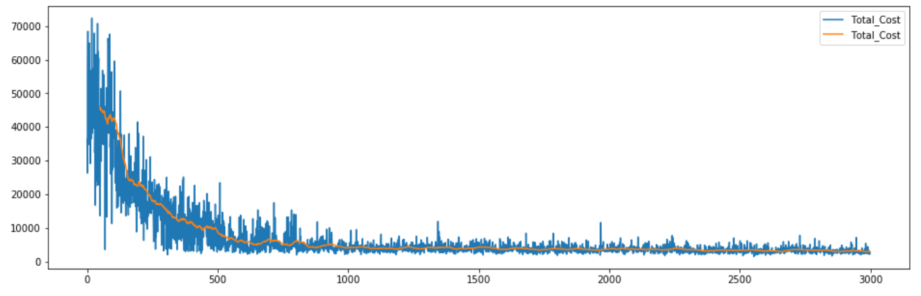
Results
The x-axis indicates the number of episodes on which the Q learning model is trained. The upper subfigure indicates the total cost
The figure show that after a number of training episodes, the AI has learned to play the simulation nearly optimally.
Conclusion: This report explained how I used a RL environment to optimize the problem
of manufacturing cost and can be seen as a good experiment to learn from.

